Slide 1

Livermore Asset Management Program:
CAMP Outreach Committee Meeting
Wednesday, May 5, 2021

Slide 2
Discussion Points
6.01 CAMP Outreach Committee Member Introductions
6.02 Report from CAMP Outreach Members
6.03 Program Updates
6.04 Asset Management Fact Sheets
6.05 Stakeholder Briefings
6.06 Next Steps

Slide 3
6.01 CAMP Outreach Committee Member Introductions

Slide 4
CAMP Q&A
Public Comment
6.01 Introductions

Slide 5
Committee Member Introductions
What is your name?
What is your occupation?
Why did you join this committee?

Slide 6
6.02 CAMP Check in

Slide 7
CAMP Outreach Committee Role
Advise
Guide and inform the process
Feedback
Share your thoughts and ideas
Connect
Establish connections between stakeholders and the Livermore AMP
Outreach
Tap into your existing networks to spread the word

Slide 8
CAMP Q&A
Public Comment
6.02 CAMP Check in

Slide 9
CAMP Discussion – Member Reports
Key Issues
What are key issues you are hearing about infrastructure?
Equity
Any infrastructure issues emerging from specific groups or locations?
Program Activities
What has been the response to the geocache, social media, and video?
Outreach
Any examples of CAMP members engaging with the community about Livermore’s assets?
Any misinformation or misunderstandings to resolve?

Slide 10
6.03 Program Updates

Slide 11
Current Program Activities
Stakeholder Engagement
Internal Project Team Meetings
Citywide Newsletter
Geocache
CAMP Outreach Committee Meetings
Outreach
Stakeholder Briefings
Communication Tools
Website – Continual Updates
Web-Based Outreach Tools
  Educational Video
  Digital Newsletter
  Social Media
  Asset Fact Sheets Development

Slide 12
CAMP Q&A
Public Comment
6.03 Program Updates

Slide 13
CAMP Discussion – Outreach Program Updates
Outreach Topics
Feedback or comments on video distribution?
Suggestions to gather more Geocache participation?
Feedback or comments on Citywide newsletter articles?

Slide 14
6.04 Asset Fact Sheets

Slide 15
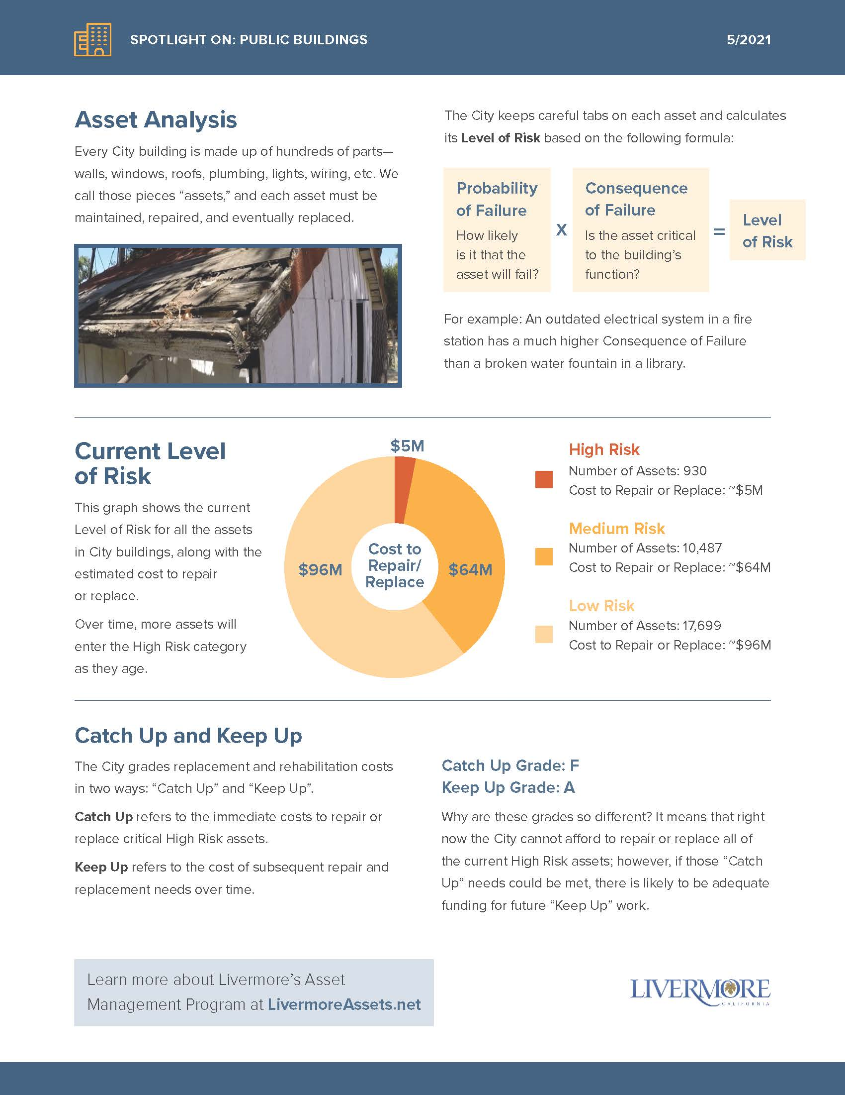
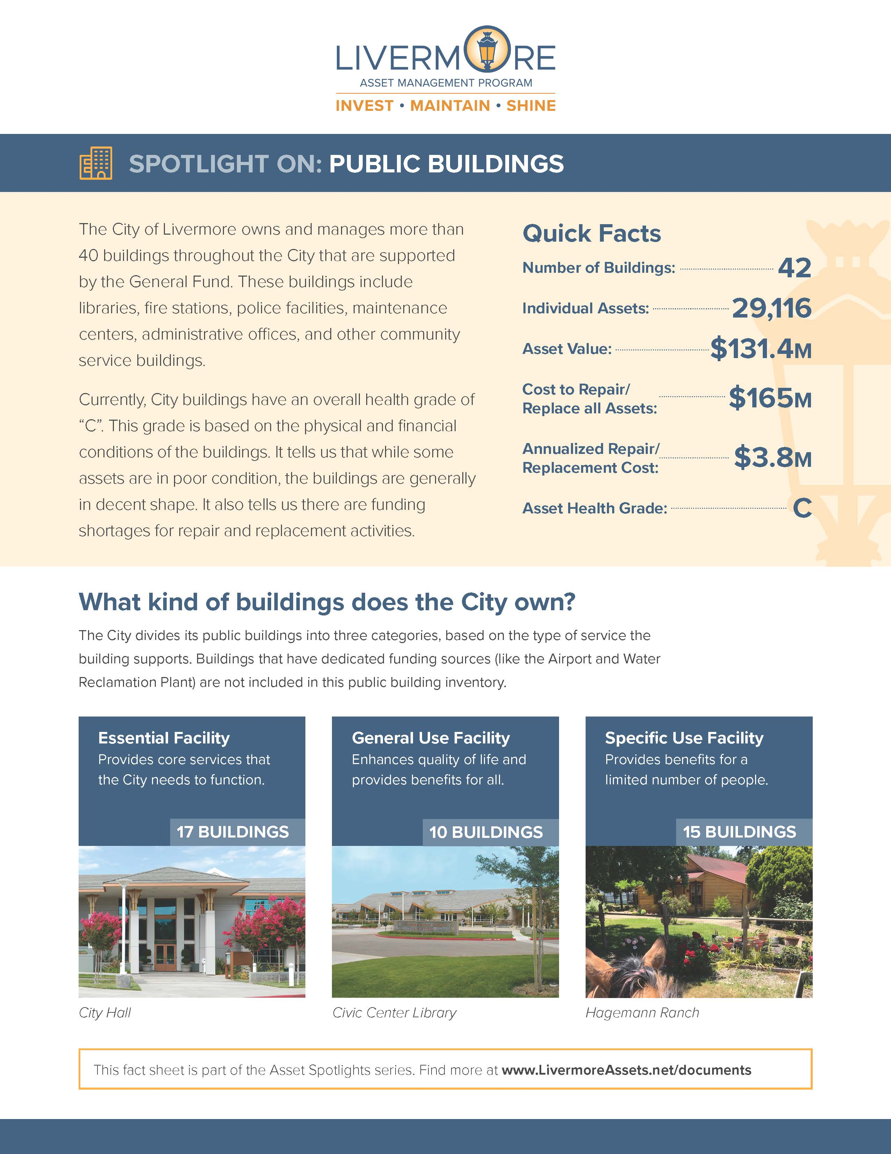
Asset Fact Sheets
Goals
Spotlight on each asset
16 assets classes
Serial publication
Promotion
Detailed backup documents available on website

Slide 16
Public Buildings Fact Sheet

Slide 17
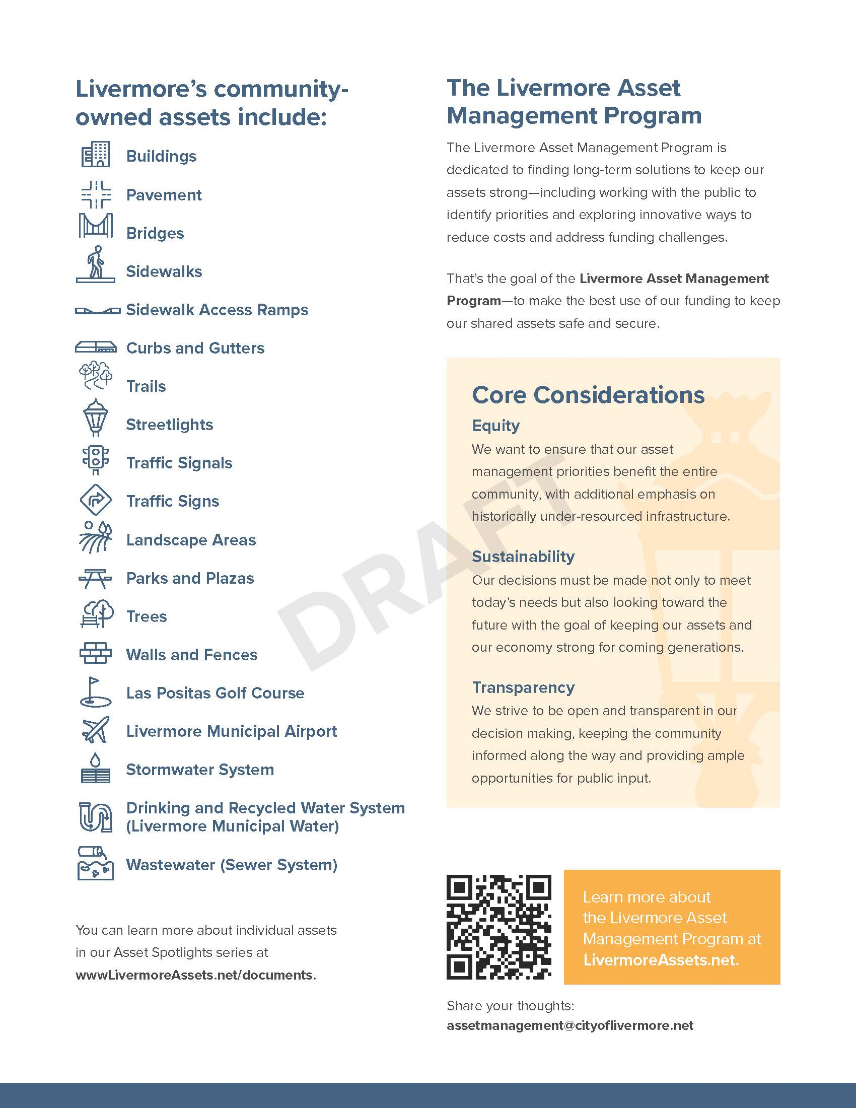
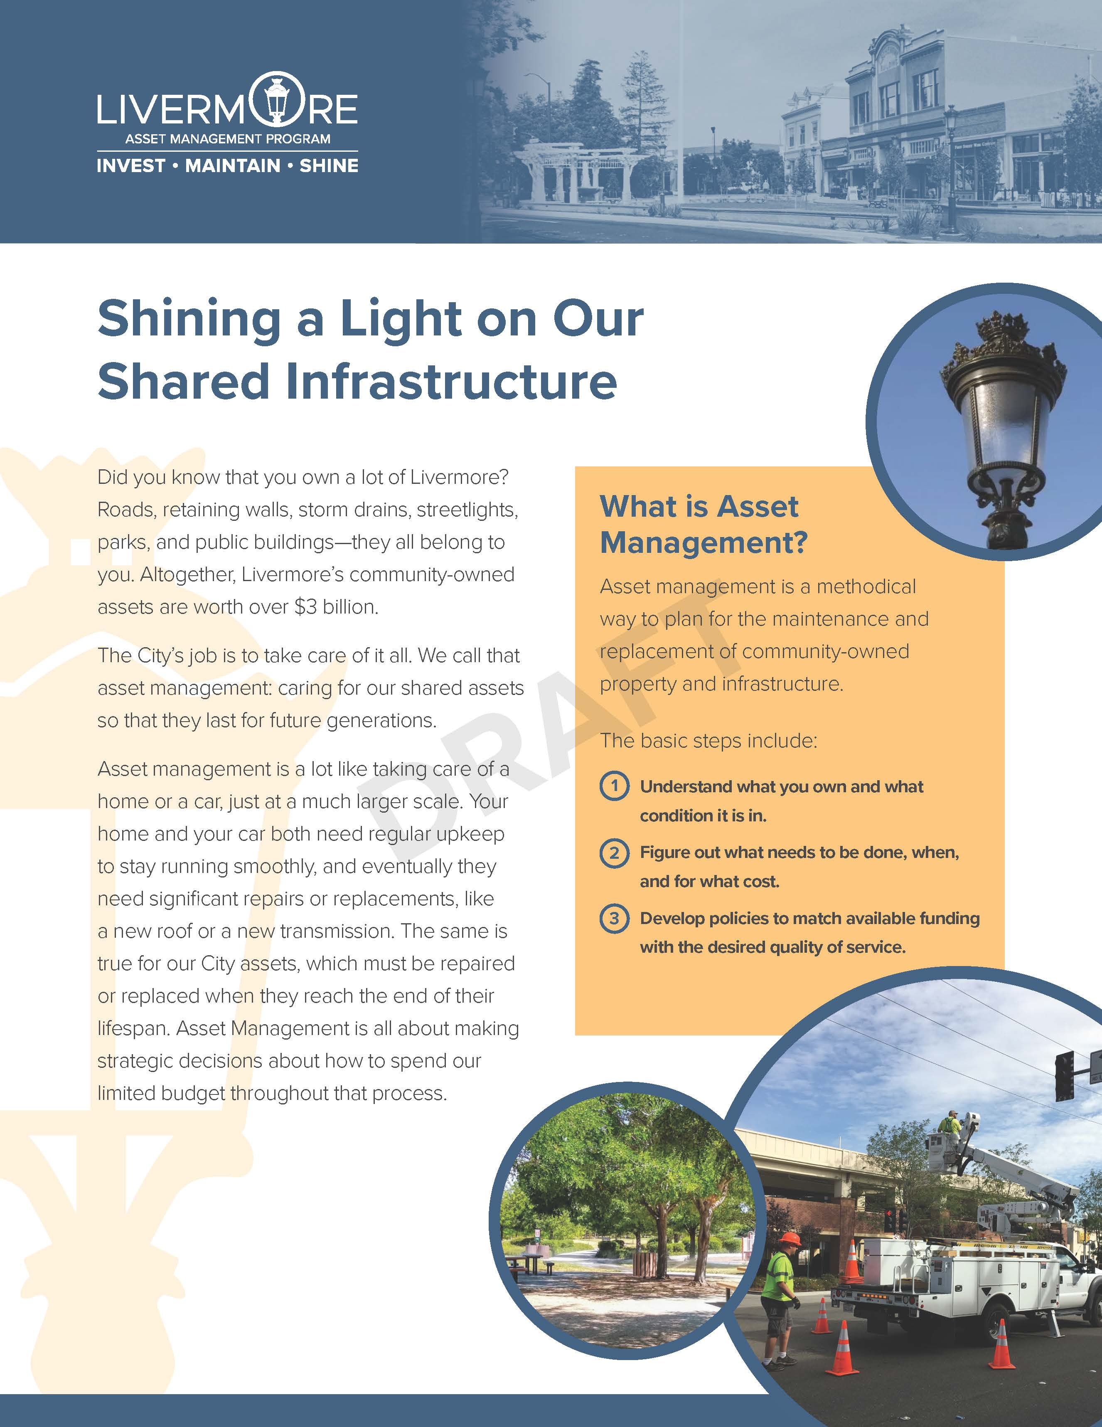
General Fact Sheet
General Program Goals
Overview of Asset Management Program
Promotion
Detailed backup documents available on website

Slide 18
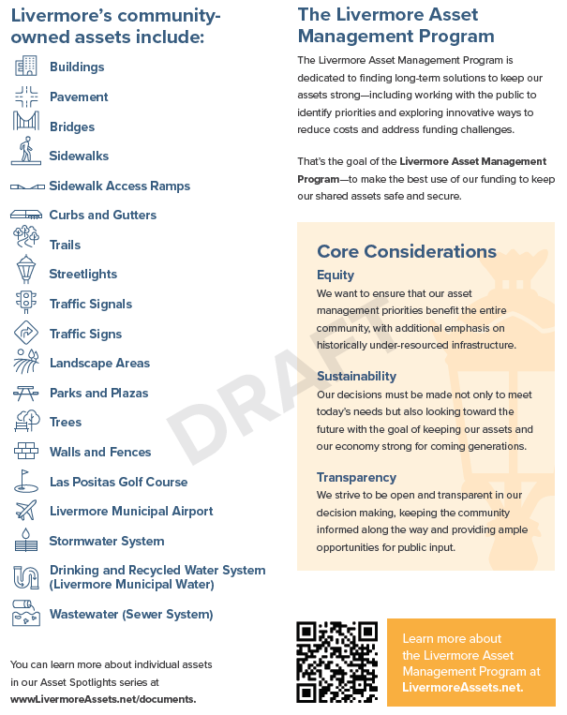

Slide 19
CAMP Q&A
Public Comment
6.04 Asset Fact Sheets

Slide 20
CAMP Discussion – Asset Fact Sheets
Design/layout feedback
Content useful?
Level of detail appropriate?

Slide 21
6.05 Stakeholder Briefings
Notes:
1. Explain purpose of the upcoming slides – CAMP Outreach Committee members use this slideshow to present at virtual meetings (Chamber of Commerce, Rotary, etc)
2. We want your feedback so we can refine this slideshow. We want you to feel comfortable with the content. Is it understandable? What needs to change?

Slide 22
Stakeholder Briefings: Key Objectives
Engage the public through community members and trusted sources
Amplify the effort and message beyond City staff
Obtain unvarnished feedback from the community
Help CAMP members prepare to discuss the asset management

Slide 23
Livermore Asset Management Program:
Community Briefings
Spring 2021

Slide 24
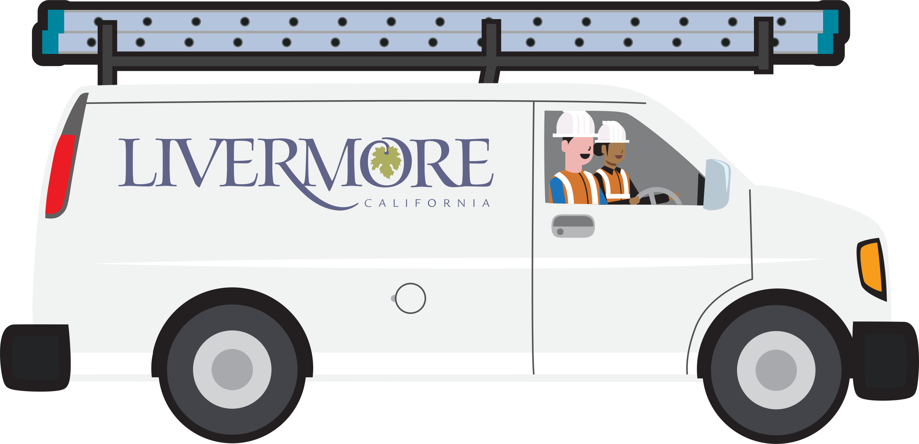
Today’s Conversation
Asset Management – an overview
Feedback on Prioritizing Assets
Strategy Discussion
Notes:
Thank you for hosting me/us today. My name is __________ and I am part of the City of Livermore’s CAMP Outreach Committee. We are group of residents that help advise the city on engaging the community about Livermore’s Asset Management Program.
Today, I just want to give you a very brief overview of the program and its role in managing and maintaining community-owned assets – that is, infrastructure and any physical elements that the city owns.
I also would appreciate your feedback on the assets that you find most important and that should be prioritized.
Lastly, we need to think generationally about this and need your help to consider long-term strategies.

Slide 25
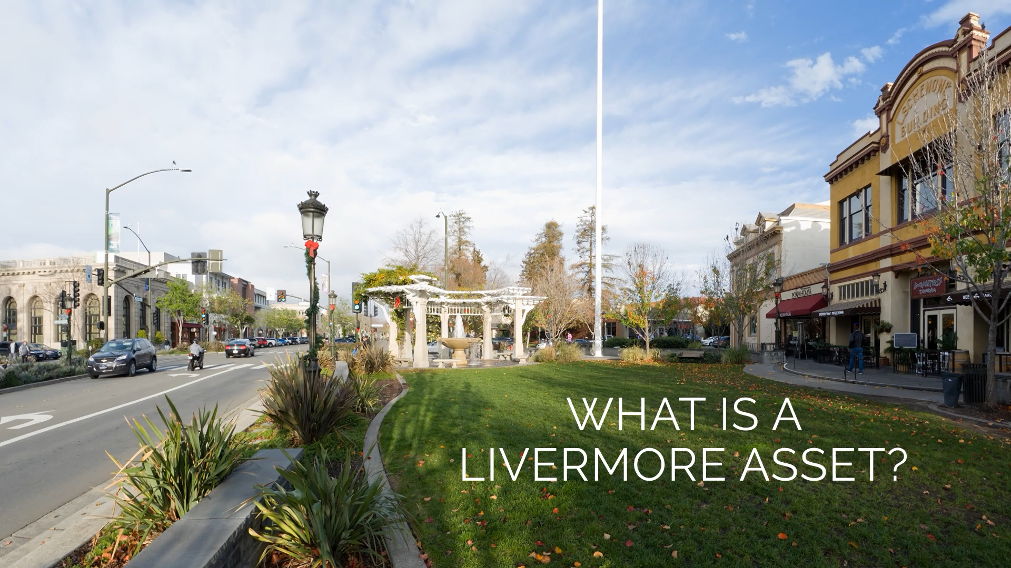
Notes:
First, we have developed this video that has made the rounds on social media that will provide an overview.

Slide 26
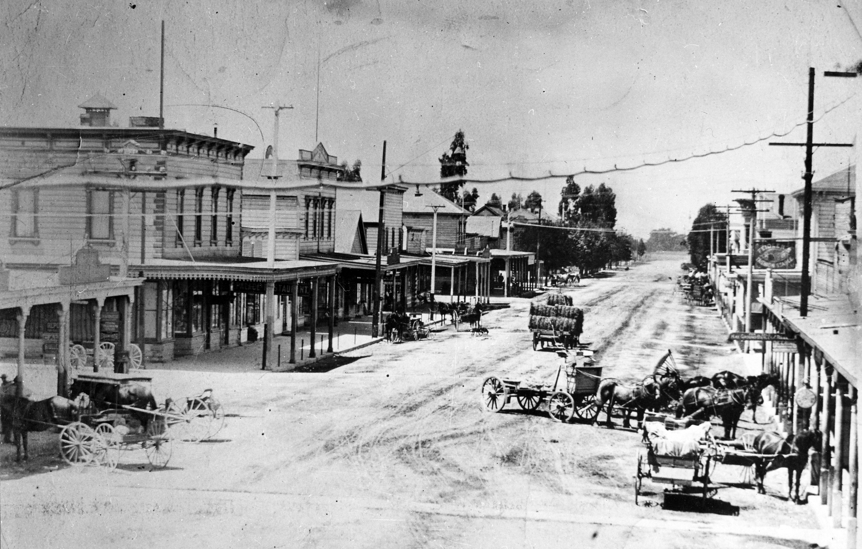
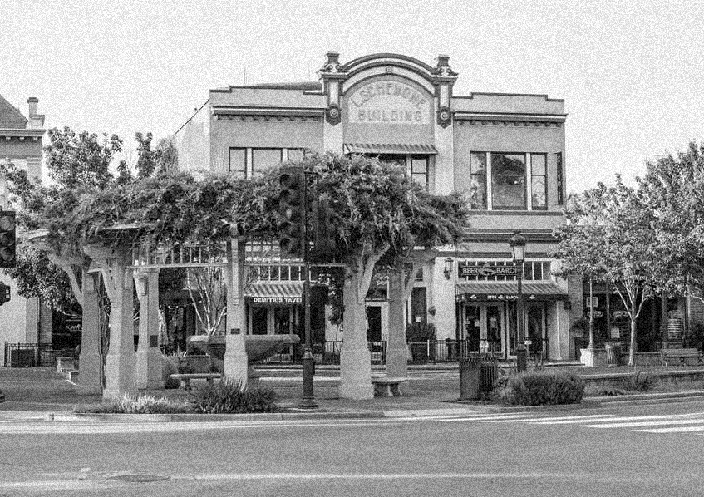
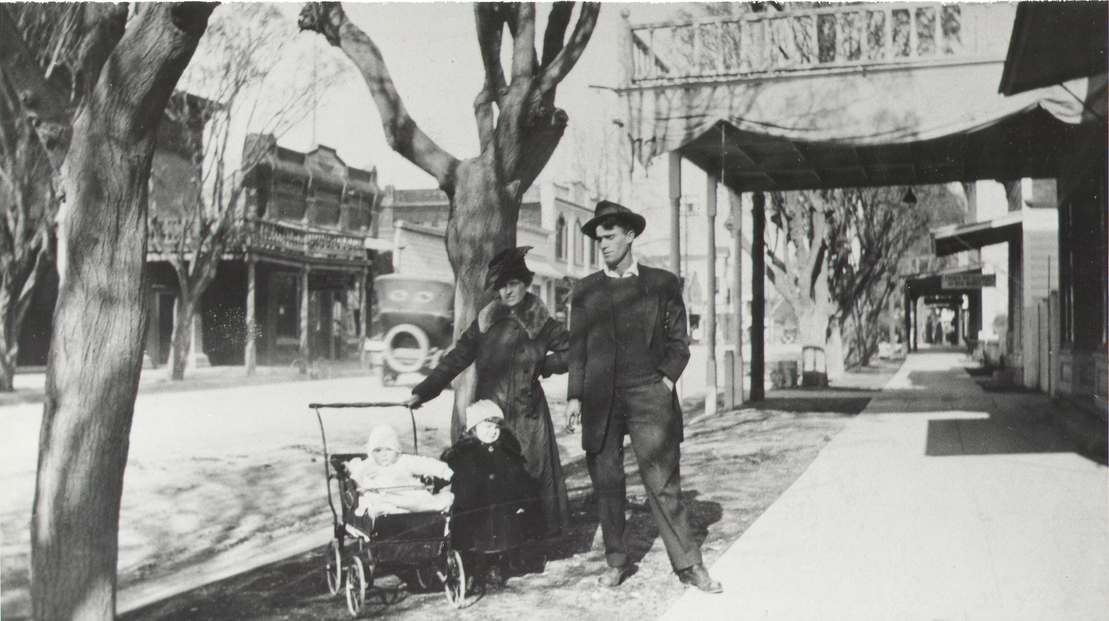
Notes:
As the video mentioned, our assets are our history of development as a city. Today, Livermore is 150 years old so it makes sense that some of our oldest infrastructure is subsequently wearing.

Slide 27
PROBLEM STATEMENT
The City of Livermore does not have sufficient funds to care for our assets at the same level of service that is expected by residents.
Notes:
So, given the aging infrastructure, we as a city have some decisions to make about how to manage our infrastructure – especially since we simply don’t have the level of resources to keep service at the same level as has come to be expected.

Slide 28
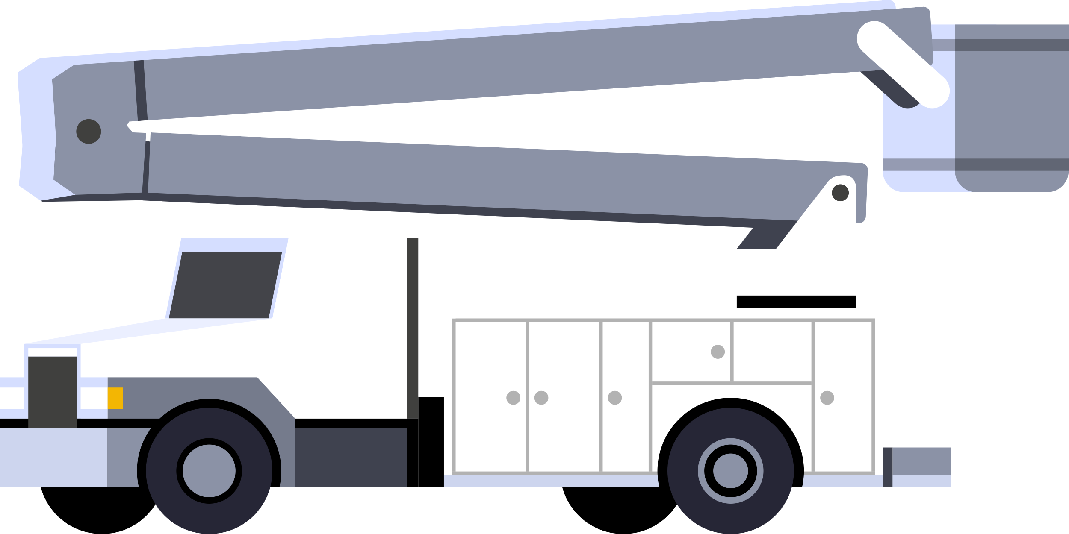

Infrastructure Dilemma
  Repair/Replace ALL Assets-
  $40 million per year
  Current Spending on Asset Repair and Replacement-
  $10 million per year
  Minimum Level of Service (High Risk Only)- $20 million per year
Notes:
Our dilemma – in a nutshell – is the same one that homeowners face: our expenses to maintain our home outweigh our resources.
We currently spend $10 million per year to on both repairs and replacing (if necessary) our city-owned infrastructure. However, we know we are falling short by $30 million per year if we chose to fixed everything that could be fixed and replaced everything that needed to be replaced. We’d still have a $10 million shortfall even if we just focused on the most high-risk assets.
And to be clear, when we say “repair” we don’t mean the day-to-day maintenance. Instead, we are talking about the more expensive repairs and replacement efforts.

Slide 29
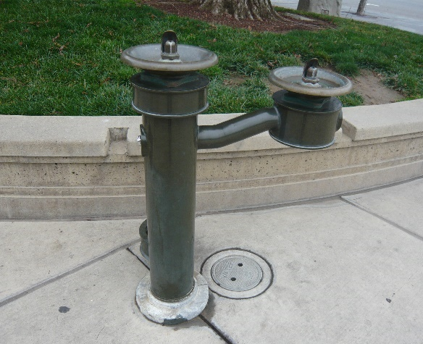
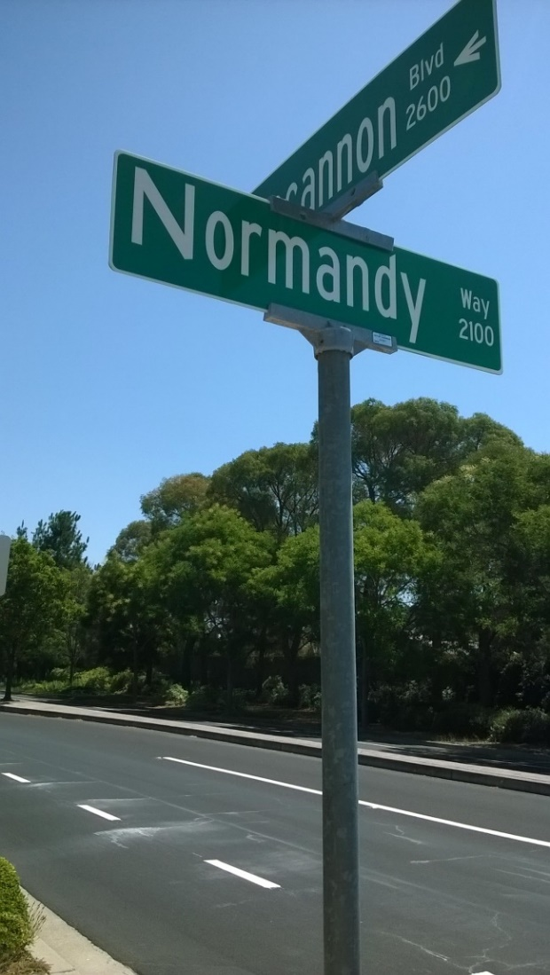
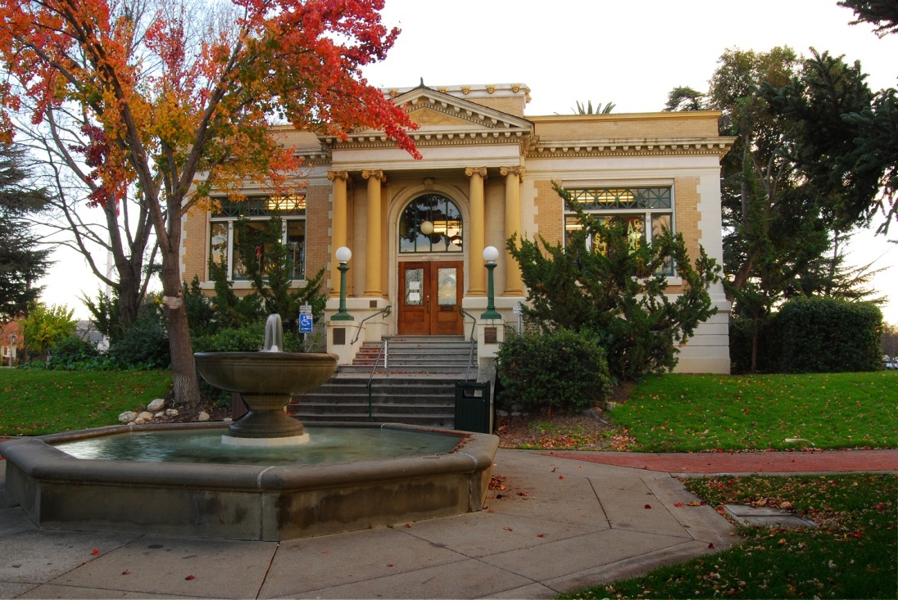
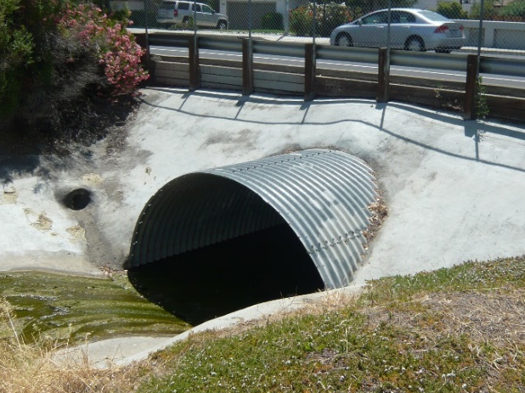
What is an asset?
Notes:
To give you a sense of what we are referring to when we say assets, we mean a wide range of components: from roads, retaining walls, storm drains, streetlights, parks and public buildings—and it all belongs to us as residents. Altogether, Livermore’s community-owned assets and public infrastructure are worth over $3 billion.

Slide 30
ASSET
An asset is something that the City owns that requires periodic rehabilitation and replacement.
Notes:
But its not just about owning these assets. The city also has to manage, maintain, and sometimes replace these assets.

Slide 31
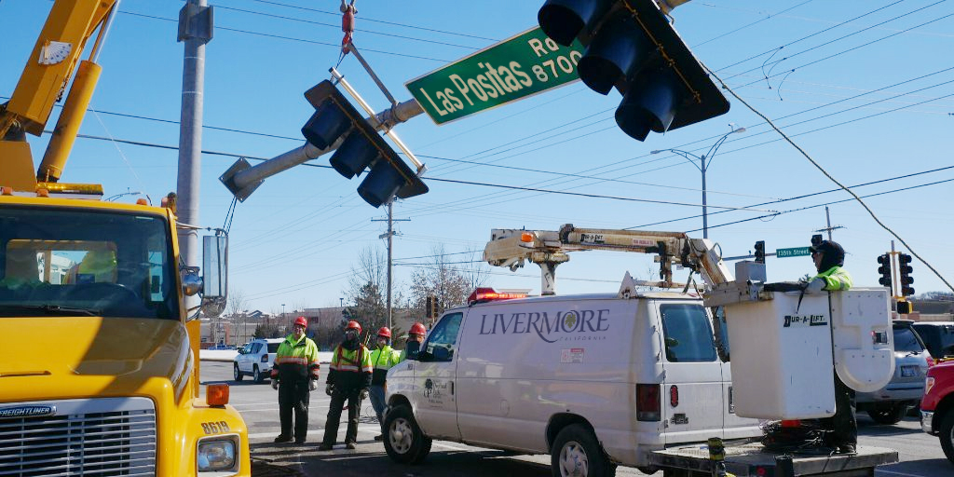
What is asset management?
Notes:
The City’s job is to take care of it all, every asset and each of its multiple components cost money on an annual basis. We call that asset management: caring for our shared resources so that they last for future generations.

Slide 32
ASSET MANAGEMENT
Ensuring the safety, quality and reliability of Livermore’s community-owned property.
Notes:
To us we are seeing Asset Management a lot like taking care of a home or a car (just at a much larger scale). It requires regular maintenance to keep things running. It also requires replacing parts that have broken or reached the end of their lifespan. And it requires making strategic decisions about how to spend a limited budget.

Slide 33
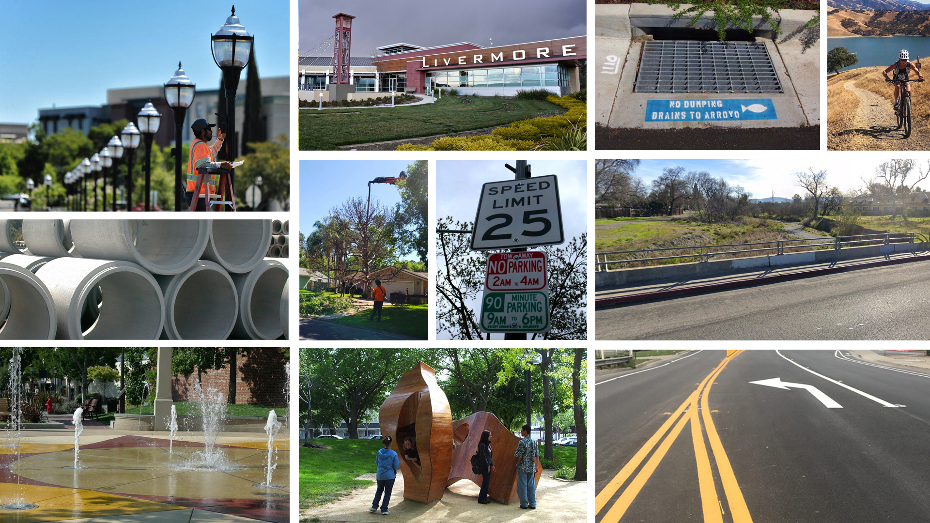

Notes:
Ultimately, that’s the goal of the Livermore Asset Management Program—to make the best use of our funding to keep our shared assets safe and secure for our community.
As you can see, Livermore’s community-owned assets include:
Streets Networks
Trails
Water Systems
Public Buildings
Plazas

Slide 34
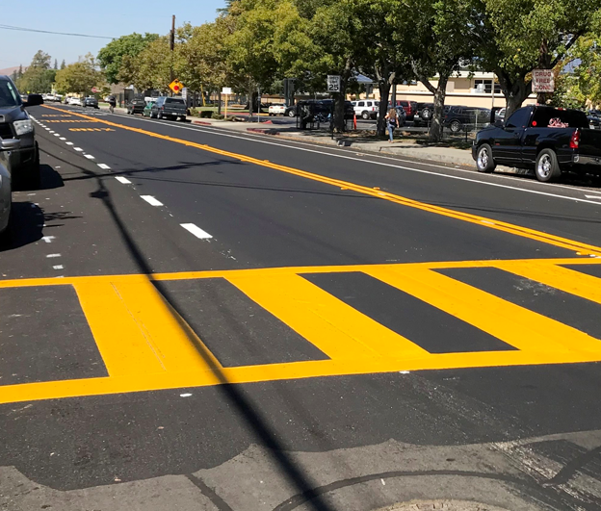
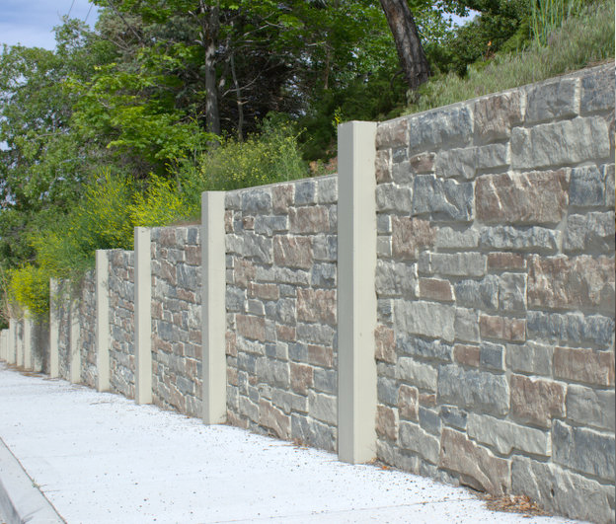
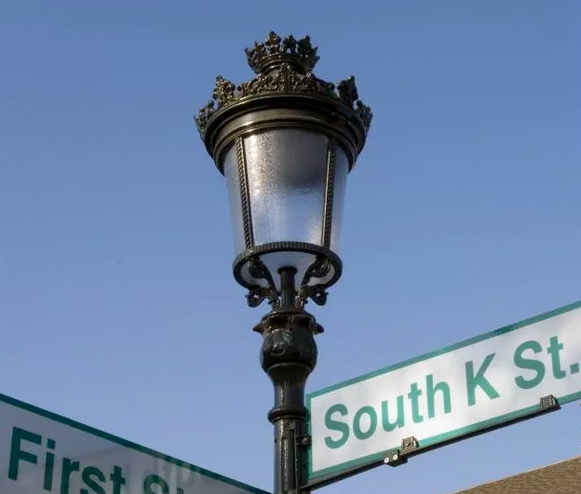
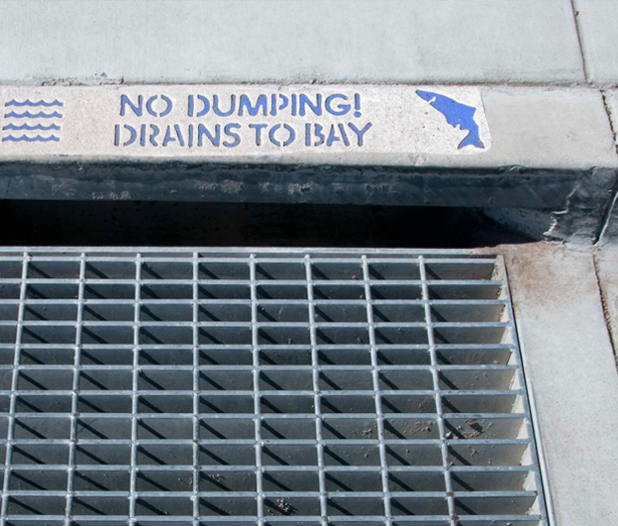
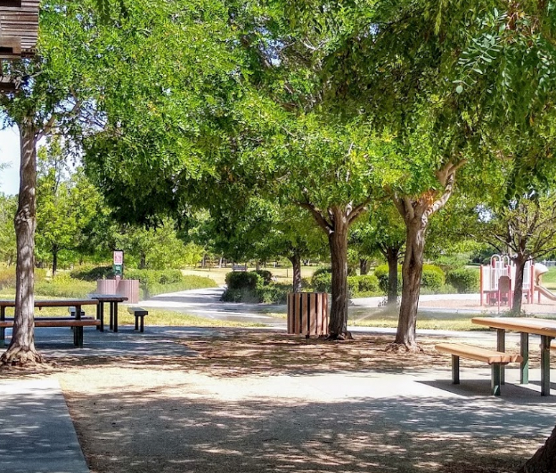
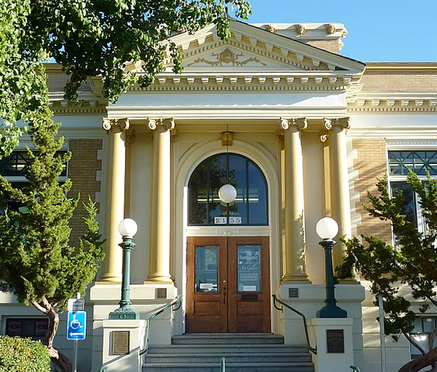
Notes:
These also include:
Some parks and recreation amenities
Components that ensure general safety
Walls and fences
And our historic assets
It’s basically everything in the City that is not owned by a private entity.

Slide 35
Overview of City Assets
General Fund
Enterprise Funds
Roadway Related
Streets
Sidewalks
Curb ramps
Curb/gutter
Bridges
Streetlights
Traffic signals
Traffic signs
Landscaped Areas
  Non-Roadway Related
  Walls/Fences
  Buildings
  Trees
  Parks/Plazas
  Trails
  Golf Course
  Stormwater System
Livermore Municipal Airport
Wastewater System (includes Livermore Water Reclamation Plant)
Recycled Water System
Drinking Water System for 1/3 of Livermore
Stormwater System
Notes:
There are many ways to categorize the assets but the sake of simplicity, the main distinction we want to convey is between General Fund Assets and Enterprise Assets.
General fund assets – are those assets that are supported by our tax dollars.
We also have assets that are funded with user fees – those we call Enterprise assets. They include things like sewer, wastewater, and the airport.
For the purposes of our discussion, we are focusing only on General Fund assets.

Slide 36
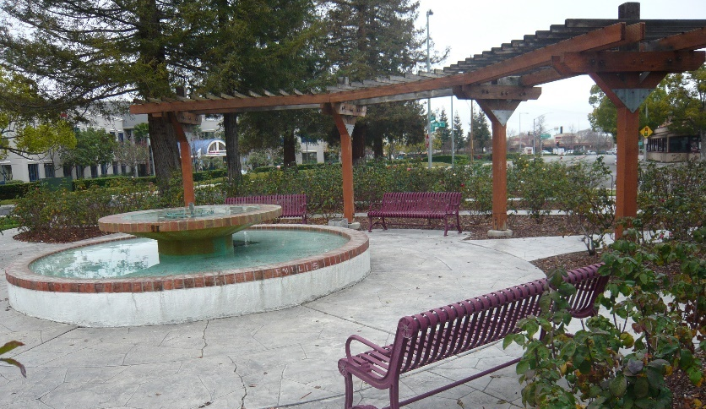
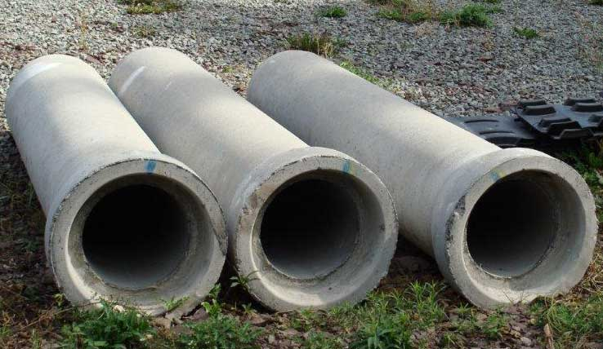
Asset Management
Program
Ensure that our community continues to receive vital services through a sustainable infrastructure strategy of:
General Fund Assets:
$2.4 billion
Enterprise Fund Assets:
$1 billion
Notes:
To give a you sense of where we are budget-wise. We have around $2.4 billion in assets that use general fund dollars. $1 billion in assets that the “user fee” or “enterprise fund” assets.
The key issue with Asset Management is that we (and many other cities in US) are not setting enough money aside – and can’t within our existing budget cycle – to fully maintain all of the assets that are owned on behalf of the public.
The good news is that our City Council has recognized the importance of this issue and has adopted it as a Council Priority. Our community, unlike most others, is being purposefully proactive. And we’re in a unique position in that most of our assets are in pretty good shape. By working on this program right now, we are hoping to address the issue before things really start falling apart and we can’t catch up.

Slide 37
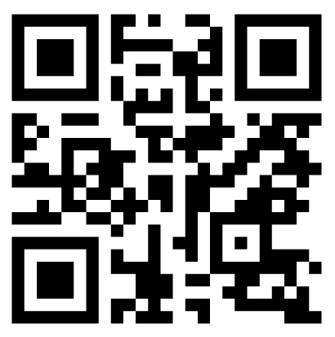

Poll: Perceptions of Assets
https://www.menti.com/ii8w45mhp7
What district do you live in?
On a scale of 1-5, how would you rate the condition of community-owned assets?
What are the top three most important assets?
What are the three least important assets?
Notes:
So, even though this is a tough conversation to have we do need your help in beginning to talk about prioritizing and strategizing our assets long-term.
To begin, we have this very brief poll that you can access by clicking on the link (place the link in the chat) or simply scanning the QR code with your phone.
After the brief question about your City Council district, we want to get a sense of how you would rate the overall general condition of our assets.
The next two questions are asking you to pick the top three important assets, from your perspective, and then your bottom three least important assets.
Don’t yet go forward with the last questions about strategies – we will do that together after a few more slides.

Slide 38
Emerging Community Priorities
Notes:
Here are the results from a question about the most/least important assets that was included in a community survey conducted in summer of 2020. Think about how your priorities compare to the emerging priorities from the survey? What surprised you? (Rhetorical)

Slide 39
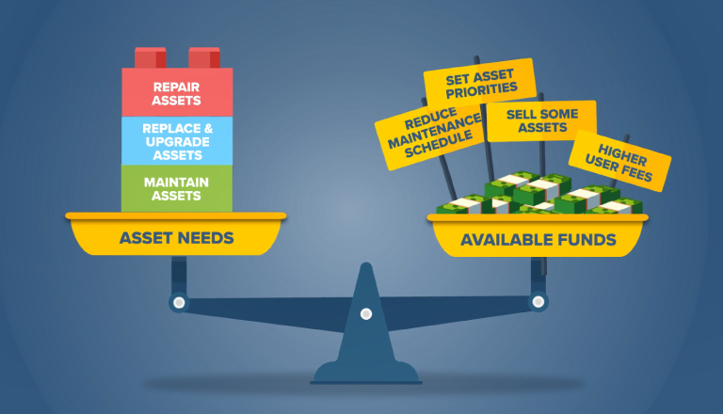
Notes:
So, we’ve established that we need at least $30M/year. This is way too much to simply shift existing City budget dollars around. We all will need to get involved in the tough choices ahead.

Slide 40
Poll: Potential Options and Solutions
A. Focus on public safety repairs and improvements.
B. Explore new grant funding opportunities, when available.
C. Focus resources
where they benefit the most people.
D. Explore new revenue enhancement measures
E. Replace high-maintenance assets with lower-maintenance alternatives.
F. Partner with private entities to share the cost of managing assets.
G. Do not replace non-essential assets when they are beyond repair.
H. Share maintenance costs with property owners when the asset directly benefits owner.
I. Sell or transfer
some assets.
J. Reduce the
frequency and level
of maintenance.
Other Ideas
Notes:
Moving forward, with community input, we need to understand the level support for these various strategies.
Focus only on repairs that bolster safe conditions.
Should we expend staff resources to try to bring in new funding streams?
Should we focus ultimately on assets most people use?
Should we consider new revenue – i.e. new taxes or fees?
Should we choose lower maintenance alternatives?
Should we look for private partnerships (for- or non-profits) that can help the city manage and share costs?
Should we let some non-essential assets go when they come to end of useful life.?
Should we shift some costs to property owners that benefit from the asset directly?
Should we put some assets up for sale?
Should we reduce the level of maintenance?
…This will be the final poll question but we’re going to talk about some alternatives in a couple of slides…

Slide 41
Thank you!

Slide 42
CAMP Q&A
Public Comment
6.05 Stakeholder Briefings

Slide 43
CAMP Discussion – Stakeholder Briefings
Information useful? Relatable tone?
Right level of detail? Right issues?
Graphics appealing?
Logistics
  Reaching groups? Partnering to present? Tracking events? Coaching session?
Polling question discussion

Slide 44
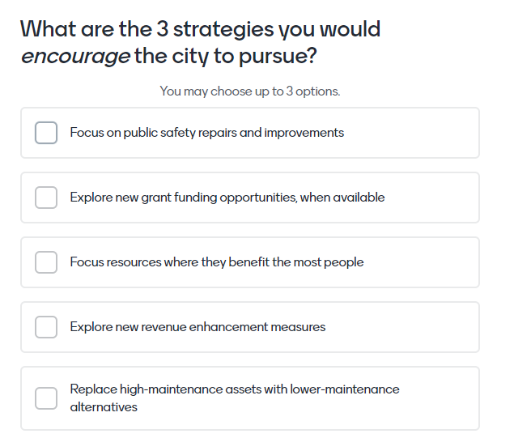
Option 1 – Top 3 / Bottom 3

Slide 45
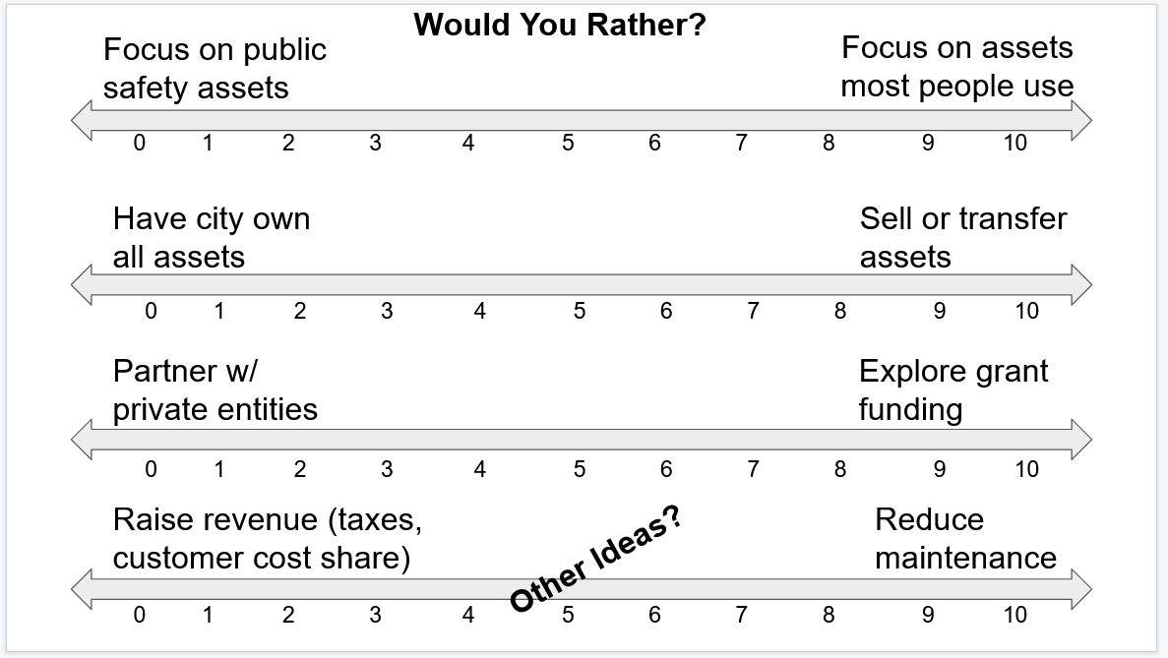
Option 2 – Comparative Continuum

Slide 46
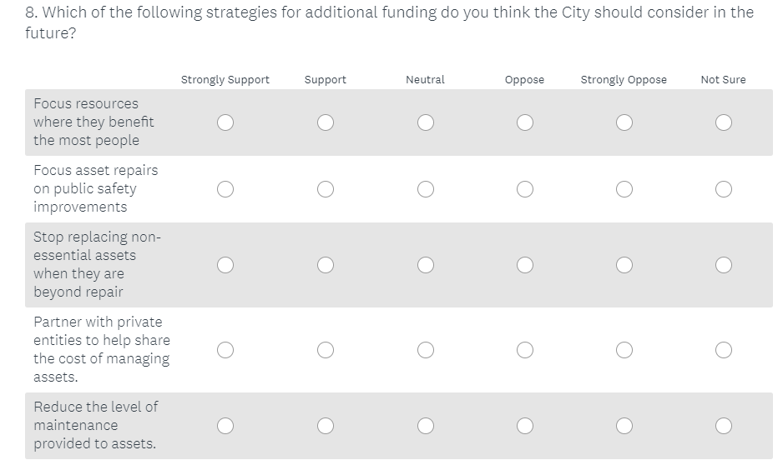
Option 3 – Level of Support

Slide 47
6.06 Next Steps

Slide 48
Next Steps
Continue to Promote Video – Use video as key tool during Stakeholder Briefings
Social Media – Campaign continues to broaden reach and promote Asset Fact Sheets
Asset Fact Sheets – Upcoming topics: Signals
Stakeholder Briefings – CAMP Outreach Committee Members present at virtual meetings of local organizations and institutions
CAMP Update to City Council – June 2021
Joint meeting with Climate Action Plan Committee – June 2021
Youth Engagement – Geocache #2
Newsletter Article – Fall 2021

Slide 49
CAMP Q&A
Public Comment
6.06 Next Steps

Slide 50
CAMP Discussion – Upcoming Outreach
CAMP Update to City Council – What to highlight?
Joint meeting with Climate Action Plan Committee – Meeting goals?
Geocache #2 – Ideas for future geocache?
Newsletter Articles – Ideas for future articles?
Stakeholder Briefings – Coordinate and track presentations at virtual meetings
Other suggestions?

Slide 51
Livermore Asset Management Program:
CAMP Outreach Committee Meeting
May 5, 2021

